Slide 1
UTILITY
AGREEMENTS, CHANGE ORDERS & Fiscal Processing
Dianah Waller – Division of Right of Way and Utilities
Karman Hall – Division of Right of Way and Utilities

Slide 2
AGREEMENTS
Districts are responsible for uploading plans and estimates (P & E) in KURTS
P & E are reviewed and approved by District Utility Supervisor (DUS) and Area Coordinator (AC)
Once approved district will upload the draft agreement for AC review & approve
Once approved district will send agreement and P & E to utility company for signature, utility company will sign and return agreement
AC will obtain Central Office signatures
Utility Program Coordinator will establish in EMARS and upload executed agreement in KURTS and associate with EMARS
Engineering Agreements – correspondence MUST be on company letterhead

Slide 3
CHANGE ORDERS
Use TC 69-004 form UTILITY / RAIL AGREEMENT CHANGE ORDER
Utility companies shall request a change order from the utility supervisor (US) for additional work and services performed and materials use on keep-cost agreements or for additional work and services and materials used that are not included and unanticipated in the agreed-upon scope of work for lump sum agreements.
A change order cannot be approved, nor can its work proceed, until:
Adequate justification of the additional costs is secured and accepted by appropriate Cabinet staff
Funding is available to reimburse the costs associated with the change order
Failure to garner prior authorization by the Cabinet may jeopardize payment to the utility company for work performed
Date extensions must be in writing and submitted by US

Slide 4
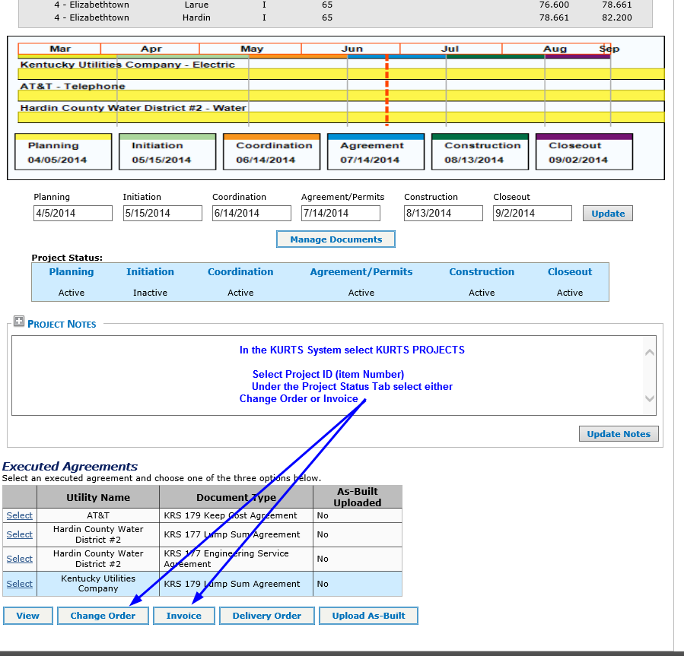
KURTS Change Orders and Statement of Charges

Slide 5
Statement of Charges in KURTS
Fields highlighted will be automatically populated

Slide 6
Change Order in KURTS
Fields highlighted will be automatically populated

Slide 7
EMARS Payment Processing

Slide 8
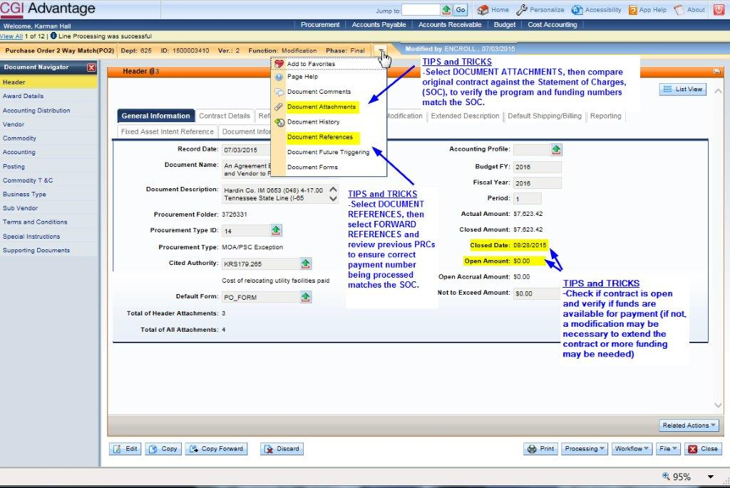

Slide 10
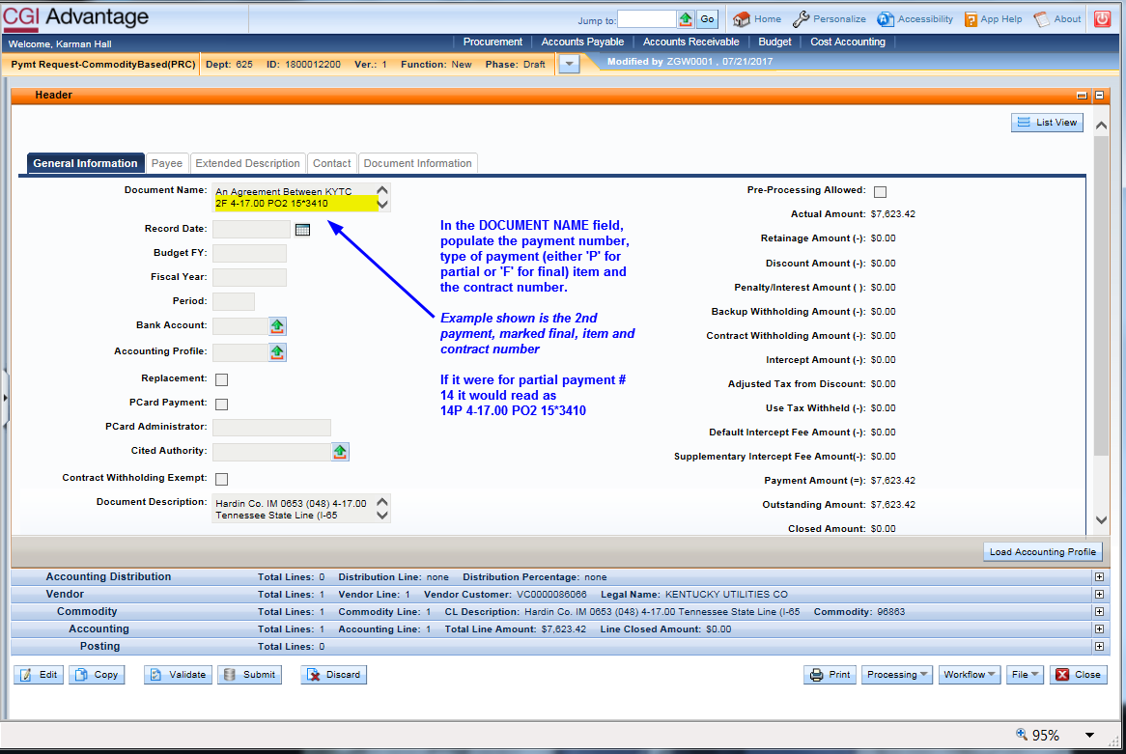

Slide 13
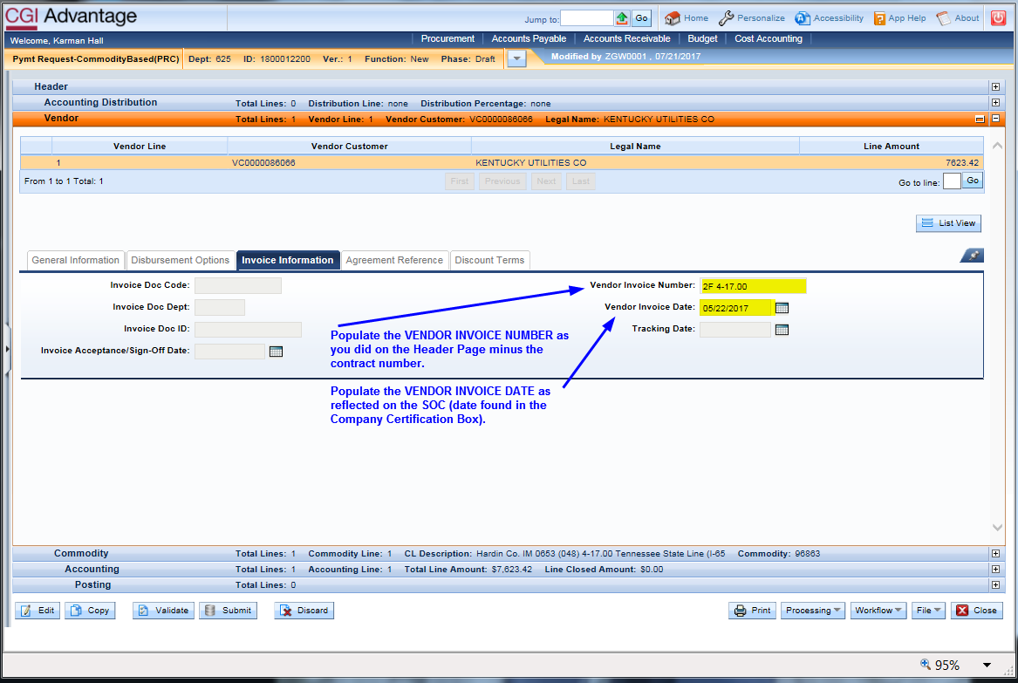

Slide 15
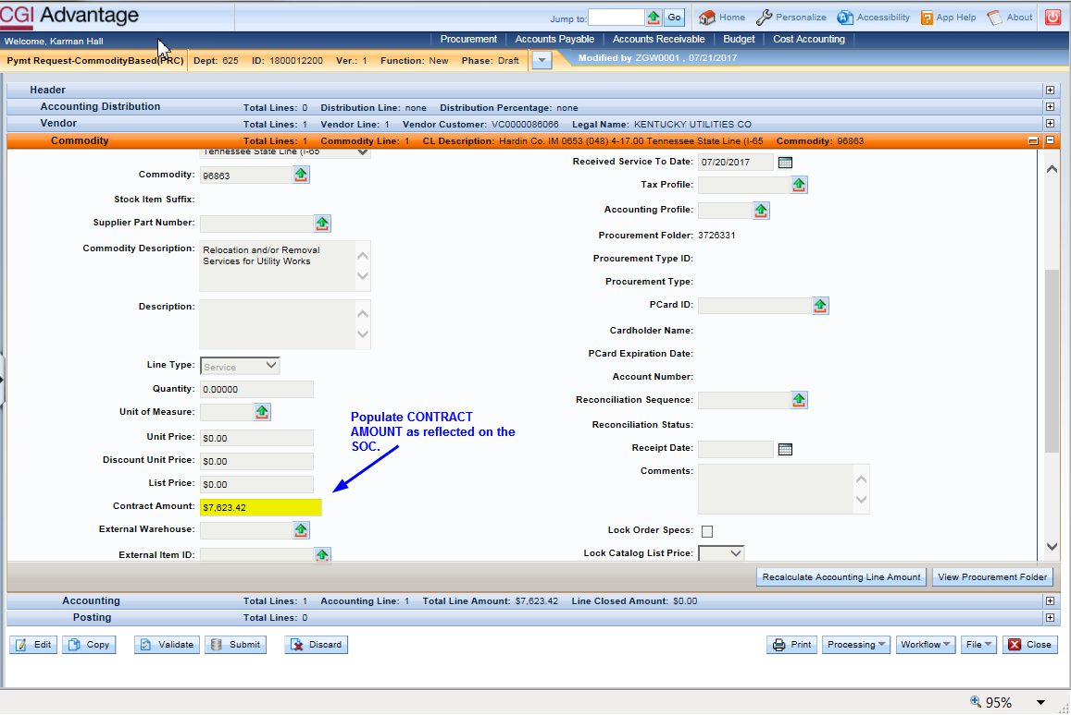

Slide 19
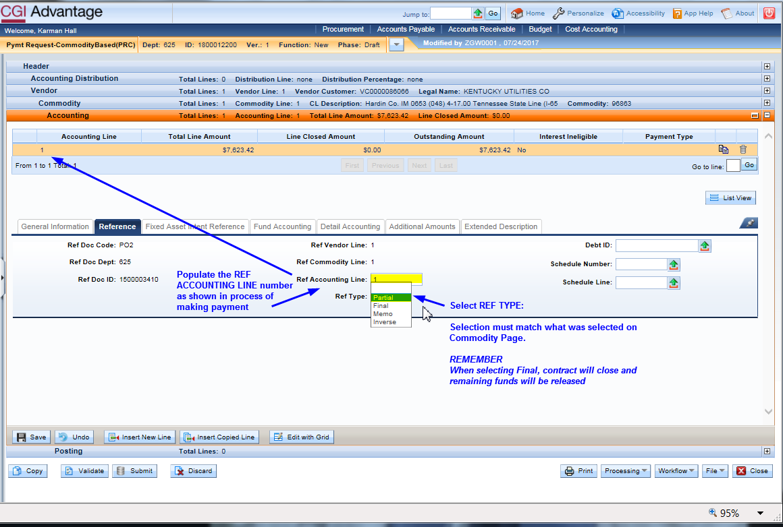

Slide 21
DO’S AND DONT’S
DO
Create SOC in KURTS, no cover memo needed
Use correct SOC form Revision dated 1-2017 (when not creating in KURTS)
Pay invoices in consecutive order, do not skip
Review supporting documentation before processing
Mark PRC as FINAL if contract can be closed, this will close contract and liquidate any remaining encumbrances
Hit the ‘Send to Account” button in KURTS only after 1st level has been applied to pay doc in EMARS

Slide 22
DO’S AND DONT’S
DON’T
Don’t duplicate payment method. (if making electronic payment do not send paper copy too)
Don’t use RED ink when making revisions or check marks on SOC.
Don’t make payments out of order
Don’t hit the ‘Send to Accounts’ button in KURTS for FINAL KEEP COST payments, they must be approved in Central Office by Jennifer

Slide 23
CENTRAL OFFICE UTILITY CONTACTS
Jennifer McCleve, Utility and Rails Branch Manager
502-782-4944 Jennifer.McCleve@ky.gov
David Otte, Area Coordinator Districts 1, 2, 3, 6
502-782-5072 David.Otte@ky.gov
Dianah Waller, Area Coordinator Districts 4, 10, 11, 12
502-782-4954 DianahC.Waller@ky.gov
Sean Johnson, Area Coordinator District 5, 7, 8, 9
502-782-4936 Sean.Johnson@ky.gov
Karman Hall, Utility Program Coordinator
502-782-4938 Karman.Hall@ky.gov

